Slide 1
ADA LOVELACE DAY 2020 - WiE Affinity Group, IEEE Bangalore section ,Bangalore section and India Council.
AI-based Poetry (Sonnet) generation
FINAL ROUND

Slide 2
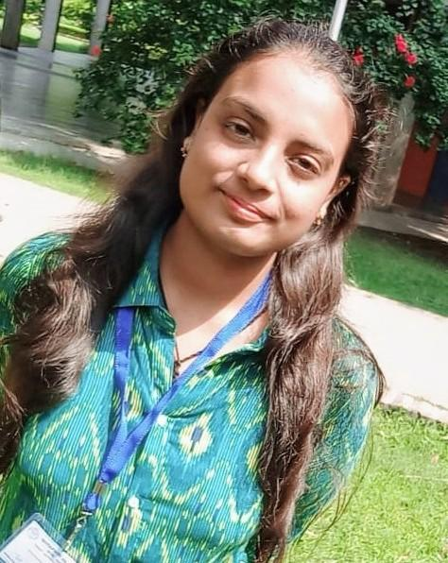
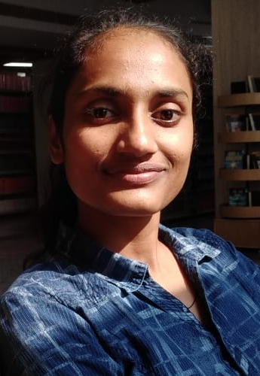
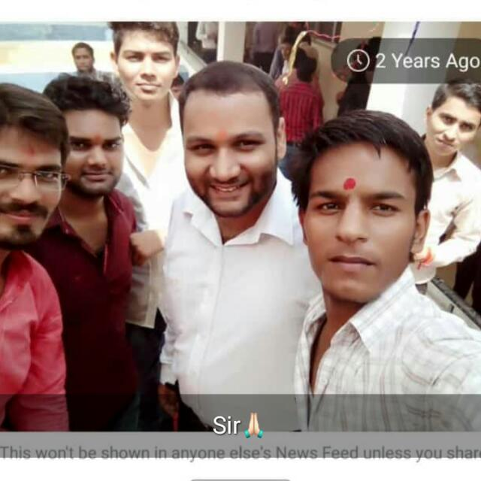

Team Members / Roles in project
Akshita Gupta
ML Developer
Project maintainer
Team Lead
Anamika Pal
Data cleaner and and resource collector
Siddharth Srivastava
RNN Developer
Nitish Mangesh Kalan
ML Developer

Slide 3
Sonnet Generation using Image Captioning
Technologies Used
GPU USED IS "GeForce GTX 1080 Ti with Compute Capability 6.1"
libraries tensorflow and numba for connecting with GPU
LSTM RNN in Python with Keras
Dataset https://cocodataset.org/#home
Final Code https://github.com/akshitagupta15june/ImageSonnetGeneration/blob/main/FinalSonnetGenerationCode/finalsonnetrun.ipynb

Slide 4
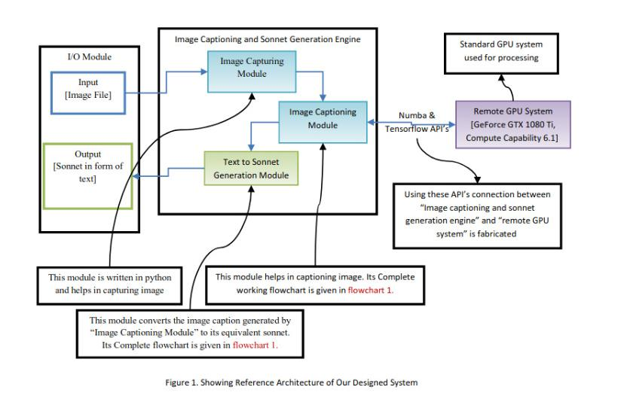
Solution Architecture

Slide 5
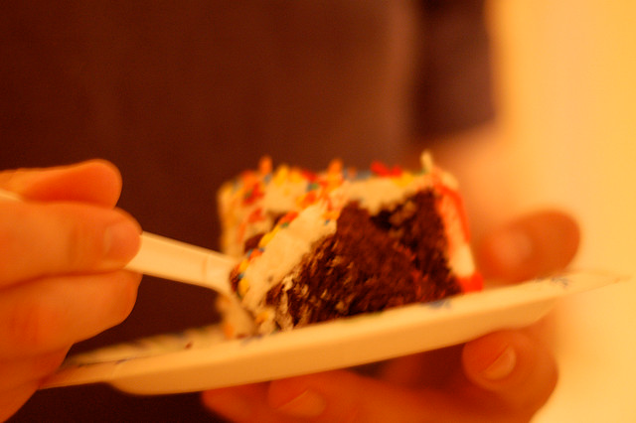
For the Result, the project is divided into two parts i.e Image Captioning + Sonnet generation from Image Caption using LSTM RNN in Python with Keras
We have downloaded the MS-COCO dataset https://cocodataset.org/#home , preprocessed it and it caches a subset of images using Inception V3, trains an encoder-decoder model, and generates captions on new images using the trained model.
Given an image like the example, our goal is to generate a caption such as”A slice of chocolate cake”

Slide 6
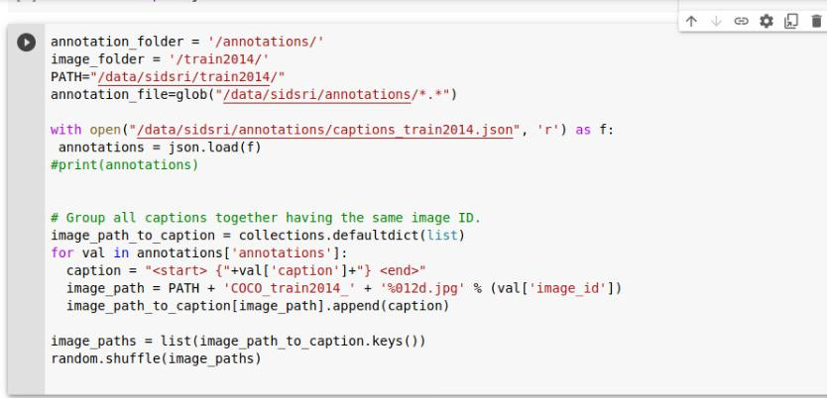
Steps of implementation in Image Captioning
To accomplish this, I have used an attention-based model, which enables us to see what parts of the image the model focuses on as it generates a caption.

Slide 7
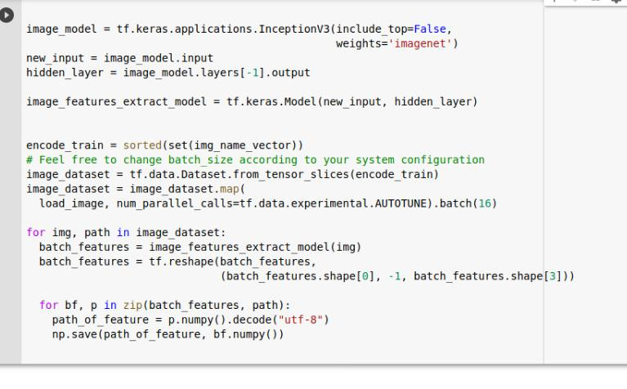
3) Preprocess the images using InceptionV3
4) Preprocess and tokenize the captions
5) Split the data into training and testing
6) Create a tf.data dataset for training

Slide 8
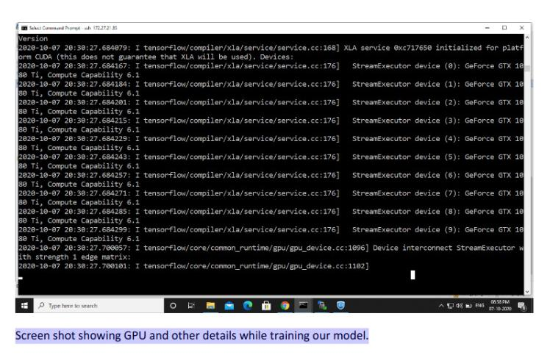
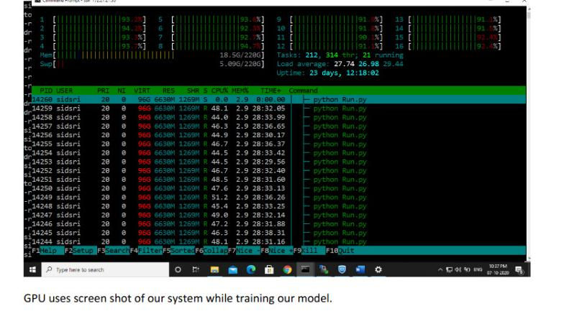
Model Checkpoint and Training our model in GPU

Slide 9
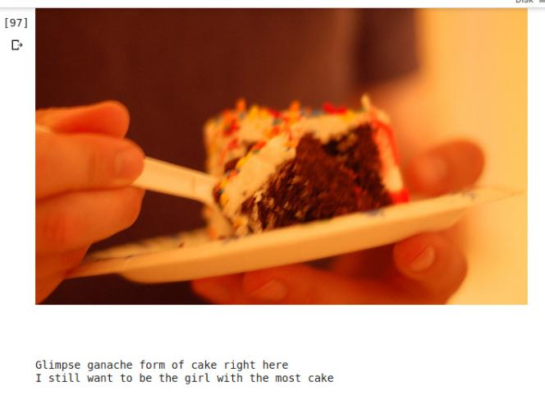
Caption Generated by uploading an image after training and testing.

Slide 10
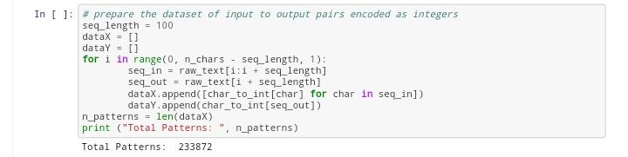
SONNET GENERATION USING THE CAPTION GENERATED BY THE IMAGE CAPTIONING
Sonnet Generation With LSTM RNN in Python with Keras
As we split up the datset into these sequences, we convert the characters to integers.We could just as easily split the data up by sentences and pad the shorter sequences and truncate the longer ones.

Slide 11
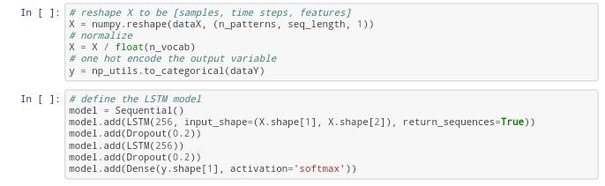
Now that we have prepared our training data we need to transform it so that it is suitable for use with Keras.
First we must transform the list of input sequences into the form [samples, time steps, features] expected by an LSTM network. Next we need to rescale the integers to the range 0-to-1 to make the patterns easier to learn by the LSTM network that uses the sigmoid activation function by default.

Slide 12
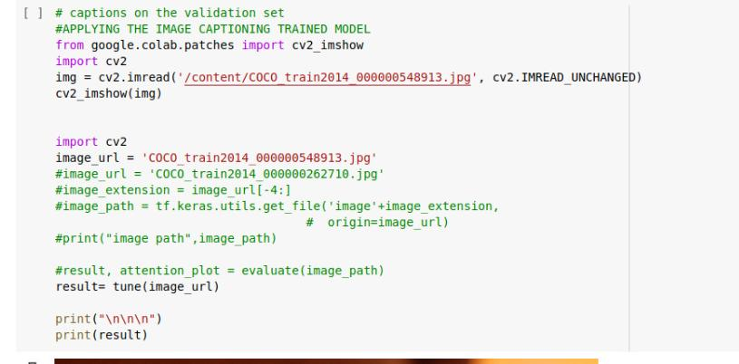
Now that we have prepared our training data we need to transform it so that it is suitable for use with Keras.
Giving the image path and storing caption in result variable

Slide 13
The network is slow to train (about 300 seconds per epoch). Because of the slowness and because of our optimization requirements, we will use model checkpointing to record all of the network weights to file each time an improvement in loss is observed at the end of the epoch.
The simplest way to use the Keras LSTM model to make predictions is to first start off with a seed sequence as input, generate the next character then update the seed sequence to add the generated character on the end and trim off the first character. This process is repeated for as long as we want to predict new characters (e.g. a sequence of 1,000 characters in length).

Slide 14
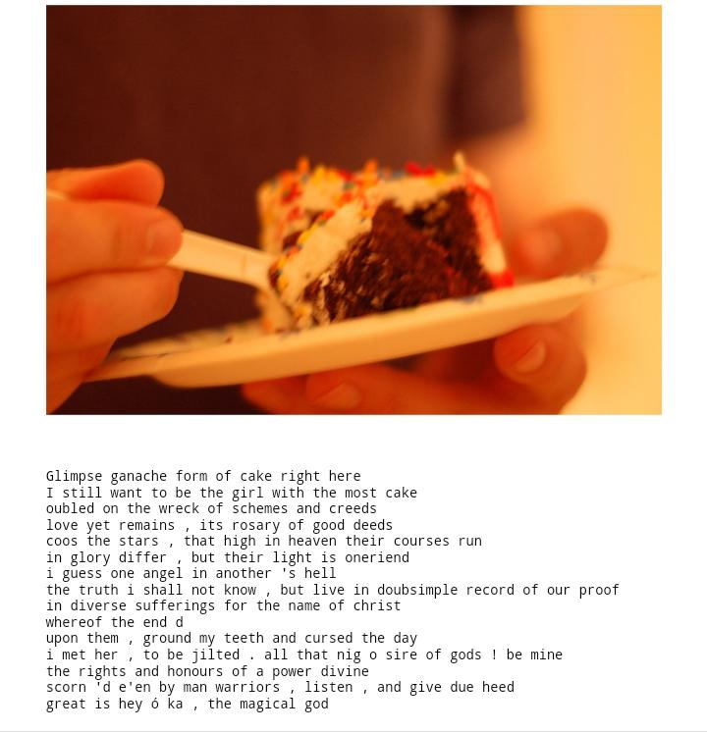
We will give text generated by the Image captioning to LSTM MODEL AND THE FINAL SONNET WILL BE GENERATED
FINAL RESULTS→>>

Slide 15
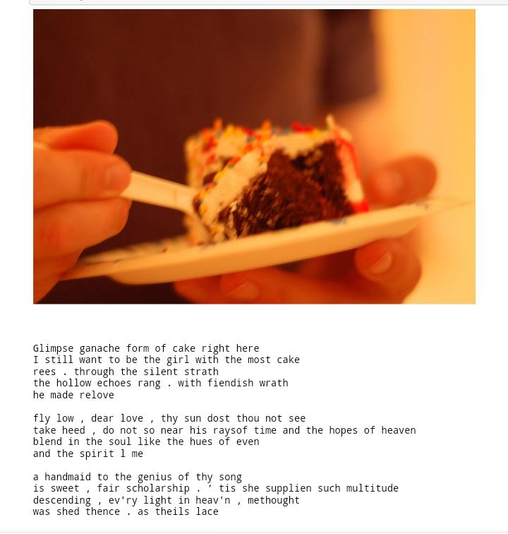
Another Results
As Sonnet is a 14 lines poem so in above results we can see that when user entered the caption from the image the poem which is generated in 14 lines have meaningful words.

Slide 16
Important links
Github repo-: https://github.com/akshitagupta15june/ImageSonnetGeneration
Datasets-: https://github.com/akshitagupta15june/AI_SonnetGeneration/tree/master/Data
https://cocodataset.org/#home
Final Codes-: https://github.com/akshitagupta15june/ImageSonnetGeneration/blob/main/FinalSonnetGenerationCode/finalsonnetrun.ipynb
Readme-:https://github.com/akshitagupta15june/ImageSonnetGeneration/blob/main/README.md

Slide 17
Reference Links
https://www.analyticsvidhya.com/blog/2017/12/fundamentals-of-deep-learning-introduction-to-lstm/
https://medium.com/mlreview/understanding-lstm-and-its-diagrams-37e2f46f1714
https://towardsdatascience.com/image-captioning-in-deep-learning-9cd23fb4d8d2

Slide 18
Thank you

